Slide 1

Using Kubernetes
Day 5
Nesia Amit

Slide 2

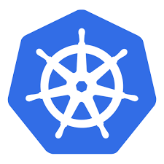
my-k8s.com/foo
80/443
80/443
nginx-controller
foo
nginx-controller
foo
foo
Master
Node#3
Docker
80/443
kublet
Node#1
kublet
foo
Docker
nginx-controller
boo
Node#2
Kubernetes Cluster
kublet
Docker

Slide 3
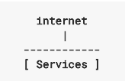
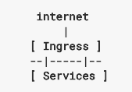
Ingress
An Ingress is a collection of rules that allow inbound connections to reach the cluster services.

Slide 4
Ingress-Controller
In order for the Ingress resource to work, the cluster must have an Ingress controller running.
Kubernetes currently support and maintain GCE and nginx controllers.

Slide 5
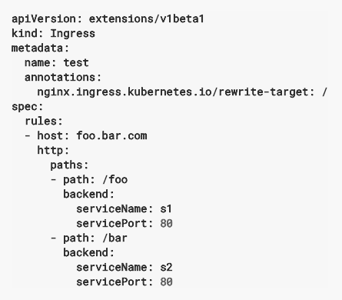

Ingress type: Simple Fanout

Slide 6
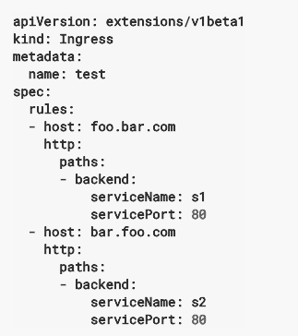

Ingress Type: Named based virtual hosting

Slide 7
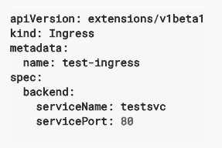
Ingress Type: Single service

